Slide 1
BIANNUAL PROJECT REPORT
April 1, 2024 – September 30, 2024

Slide 2
Coast Community College District
Program Summary
Closed Projects
CCC College Center Restroom Renovation
CCC Energy Efficiency Projects
CCC Le-Jao Student Resource Center
CCC GG Center Solar P/V Carport System
CCC Newport Beach Student Support Center
CCC Student Services Center
GWC Campus Safety/Community Education Building & Campus Entry
GWC Elevator Repairs/Replacement
GWC Rehabilitation Center Remodel
GWC Campus-wide Wayfinding/Signage
GWC Math & Science Improvements
GWC MDF/Communications Relocation
GWC Technology Projects
GWC Security & Access Infrastructure
GWC Criminal Justice Training Center
Closed Projects (cont.)
GWC Energy Efficiency Upgrades
GWC Student Services Center
GWC Math/Science Building
GWC Classroom Improvement Projects
OCC IDC Phase I (Business, Math, Computing Center)
OCC Clark Center
OCC Energy Efficiency Projects
OCC Planetarium
OCC Solar PV/Adams Parking Lot Improvements
OCC Recycling Center
OCC Legacy Hall
OCC Watson Hall Renovation
OCC Technology Projects
OCC Securitization Fund
OCC Sustainable Landscape Improvements
BIANNUAL REPORT: 4/1/24 – 9/30/24
Page 2

Slide 3
Coast Community College District
Program Summary
Closed Projects (cont.)
OCC Student Union Complex
OCC Adaptive PE, Gym & Pool
OCC Adams Lot Re-Paving
OCC Watson Hall Improvements
OCC Language Arts/Social Sciences Building
OCC Maritime Academy Expansion
DIST Technology Projects
Other Ongoing Projects
CCC Technology Projects
In Design
GWC Fine Arts Renovation
State Funded Project Proposals
GWC Physical Education Rec (Gym) Replacement
OCC Skills Center Renovation/Replacement
Future Projects
CCC Le-Jao Parking Expansion
GWC Administration Demolition
OCC Social Sciences and Existing Chemistry Demolition
Financial Closing
GWC Language Arts Complex
Projects In Construction
OCC Chemistry
GWC General Education Demolition & Native Gardens Expansion
BIANNUAL REPORT: 4/1/24 – 9/30/24
Page 3

Slide 4
Coast Community College District
Split Budget Summary
Project | Total Budget | Non-Measure M | Measure M
CCC EE – GG Ctr. Boiler | $1,270,525 | $512,011 | $758,514
GWC Language Arts Complex | $54,675,848 | $19,670,543 | $35,005,305
GWC Criminal Justice Training Center | $27,765,999 | $900,000 | $26,865,999
GWC EE – Exterior Lighting Retrofit | $513,409 | $505,914 | $7,495
GWC EE – Interior Lighting Retrofit | $432,088 | $422,013 | $10,075
GWC Gen Ed Demolition & Nature Park Expansion | $4,500,000 | $3,000,000 | $1,500,000
GWC Fine Arts Renovation | $35,261,219 | $16,004,000 | $19,257,219
OCC Language/Social Science Building | $74,941,728 | $30,353,000 | $44,588,728
OCC EE – Exterior Lighting Retrofit | $1,369,092 | $679,189 | $689,903
OCC SL – Landscape Improvements | $1,008,000 | $125,000 | $883,000
OCC Adams Lot Repaving | $1,600,000 | $100,000 | $1,500,000
OCC Chemistry | $44,487,553 | $20,194,000 | $24,293,553
OCC EE – Campus Sub-metering Project | $1,311,306 | $634,000 | $677,306
TOTALS | $249,136,767 | $93,099,670 | $156,037,097
BIANNUAL REPORT: 4/1/24 – 9/30/24
Page 4

Slide 5
Coastline College
Technology Projects
TOTAL ALLOCATION: $4,384,005
Project | Budget | Biannual Expenses | Total Expended | Balance Remaining
TECH – Classroom Technology Upgrades | $1,900,015 | $0 | $1,400,015 | $500,000
TECH – IT Infrastructure Improvements | $1,197,065 | $0 | $1,197,065 | $0
TECH – Student Kiosks, Wayfinding Signages | $1,286,925 | $0 | $286,925 | $1,000,000
Totals | $4,384,005 | $0 | $2,884,005 | $1,500,000
BIANNUAL REPORT: 4/1/24 – 9/30/24
Page 5

Slide 6
Golden West College
Language Arts Complex
Current Phase: Financial Closing
Architect: HMC Architects Contractor: Multi-Prime
Construction Manager: Sundt Construction
Construction of a new three-story 65,500 square foot instructional facility to replace 60 year old social sciences classrooms and 50 year old literature and languages building

Slide 7
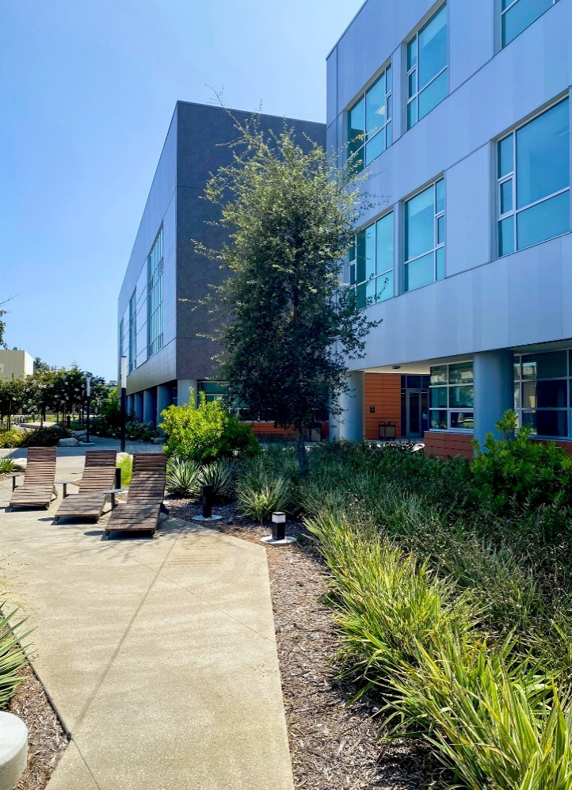
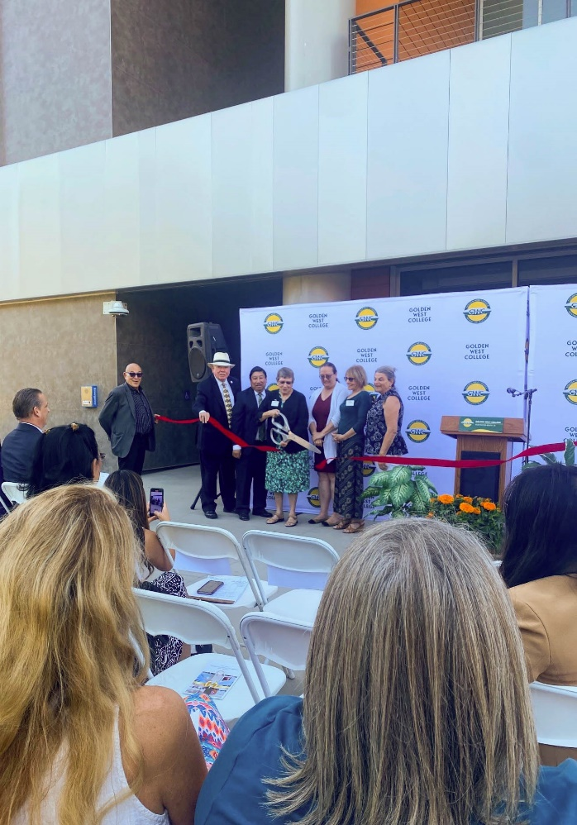
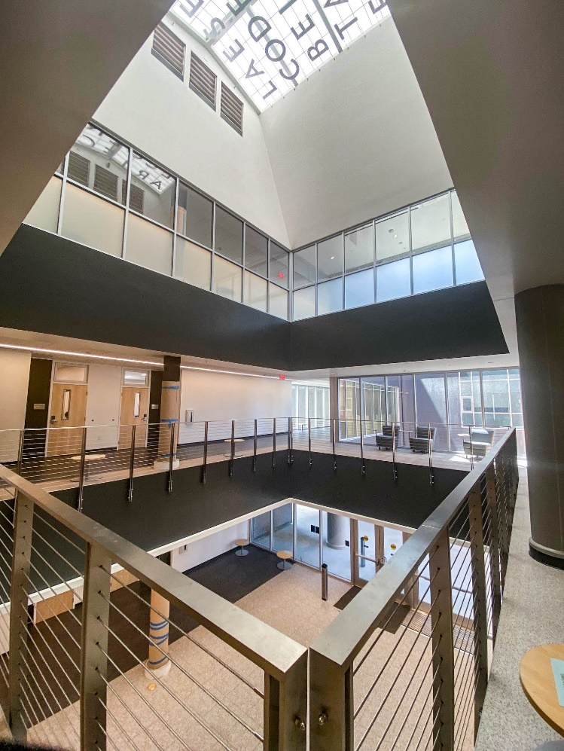
Golden West College
Language Arts Complex

Slide 8
Golden West College
Language Arts Complex
 | Budget | Biannual Expenses | Total Expended | Balance Remaining
Construction | $25,517,672 | $2,317,964 | $22,514,094 | $3,003,578
Soft Cost | $5,609,285 | $33,847 | $5,600,191 | $9,094
FFE/IT | $2,898,348 | ($28,566) | $2,811,323 | $87,025
Contingency | $980,000 |  |  | $980,000
TOTAL | $35,005,305 | $2,323,245 | $30,925,608 | $4,079,697
BUDGET
 | Start
Design | August 2018
Plan Review | August 2019
Bidding | November 2020
Construction | January 2021
Project Completion | May 2023
Closeout | August 2023
Status Update: Project is completed. Final DSA closeout nearing completion.
*The Language Arts Complex is a 50/50 state funded project. Total project funding is captured in the split budget summary slide.
SCHEDULE
BIANNUAL REPORT: 4/1/24 – 9/30/24
Page 8

Slide 9
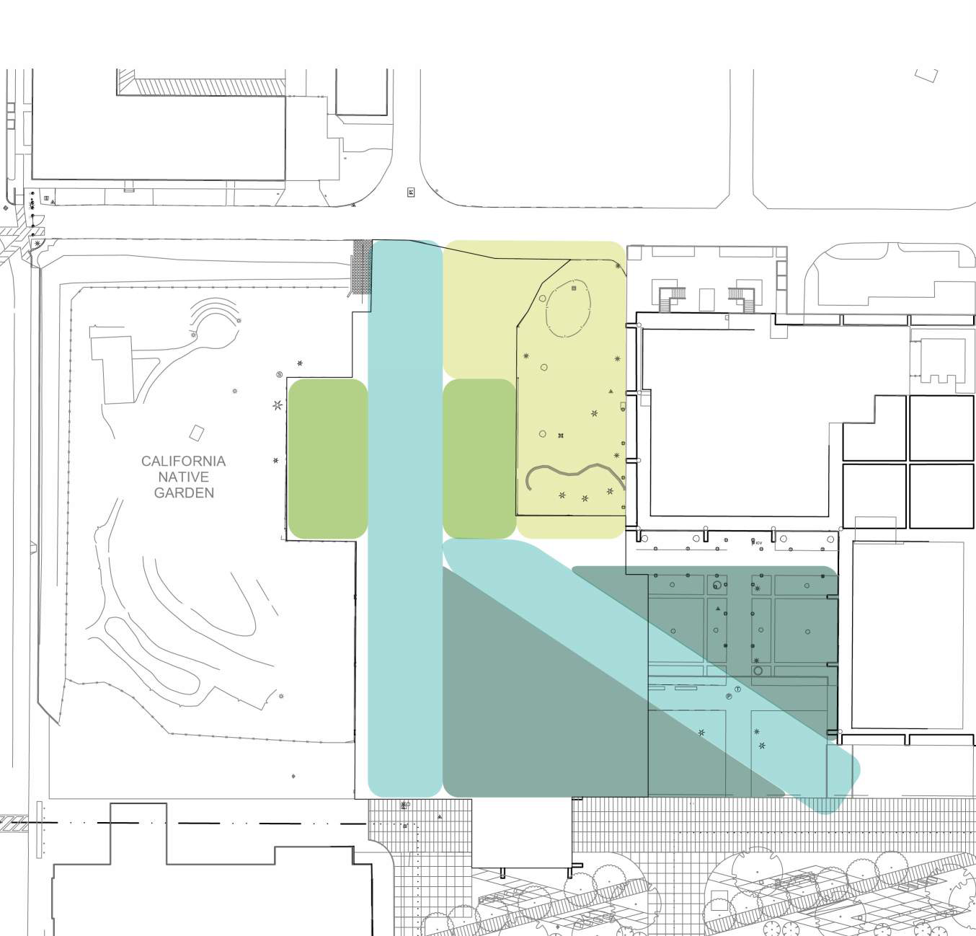
Golden West College
General Education Demolition and Nature Park Expansion
Current Phase: In Construction Architect: HMC Architects Contractor: Multi-Prime
Construction Manager: N/A
Demolition of the existing Golden West College General Education Building and New Site Work Improvements to expand access and usage of the existing Nature Garden.

Slide 10
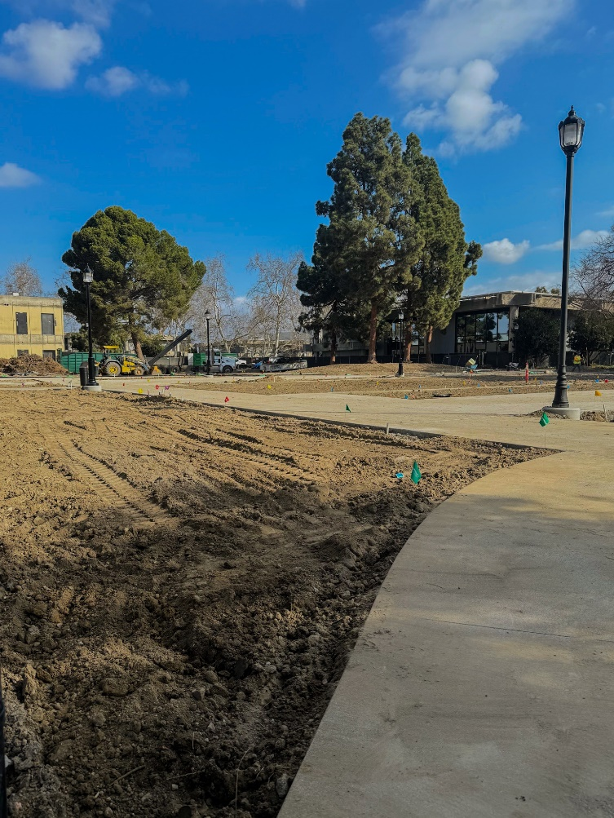
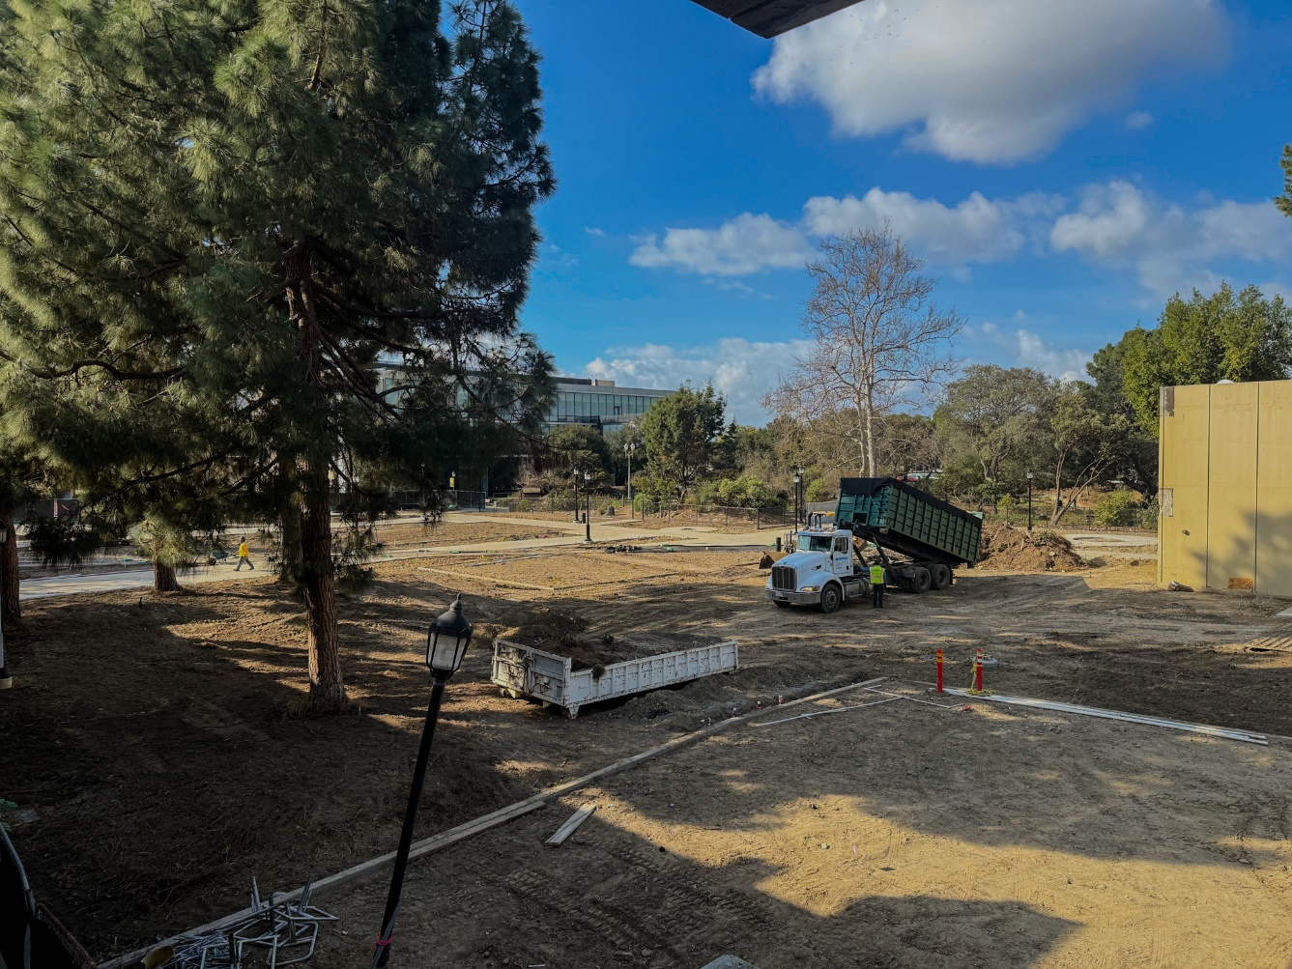
Golden West College
General Education Demolition and Nature Park Expansion

Slide 11
Golden West College
General Education Demolition and Nature Park Expansion
 | Budget | Biannual Expenses | Total Expended | Balance Remaining
Construction | $1,000,000 | $536,527 | $1,761,697 | ($761,697)
Soft Cost | $250,000 | $28,786 | $37,803 | $212,197
FFE/IT | $0 | $0 | $0 | $0
Contingency | $250,000 |  |  | $250,000
TOTAL | $1,500,000 | $565,313 | $1,799,500 | ($299,500)
BUDGET
 | Start
Design | January 2023
Plan Review | May 2023
Bidding | June 2023
Construction | August 2023
Project Completion | October 2024
Closeout | November 2024
Status Update: Site landscaping and electrical work ongoing.
SCHEDULE
*General Education Demolition and Nature Park Expansion is only partially funded using Measure M. Total project funding is captured in the split budget summary slide.
BIANNUAL REPORT: 4/1/24 – 9/30/24
Page 11

Slide 12
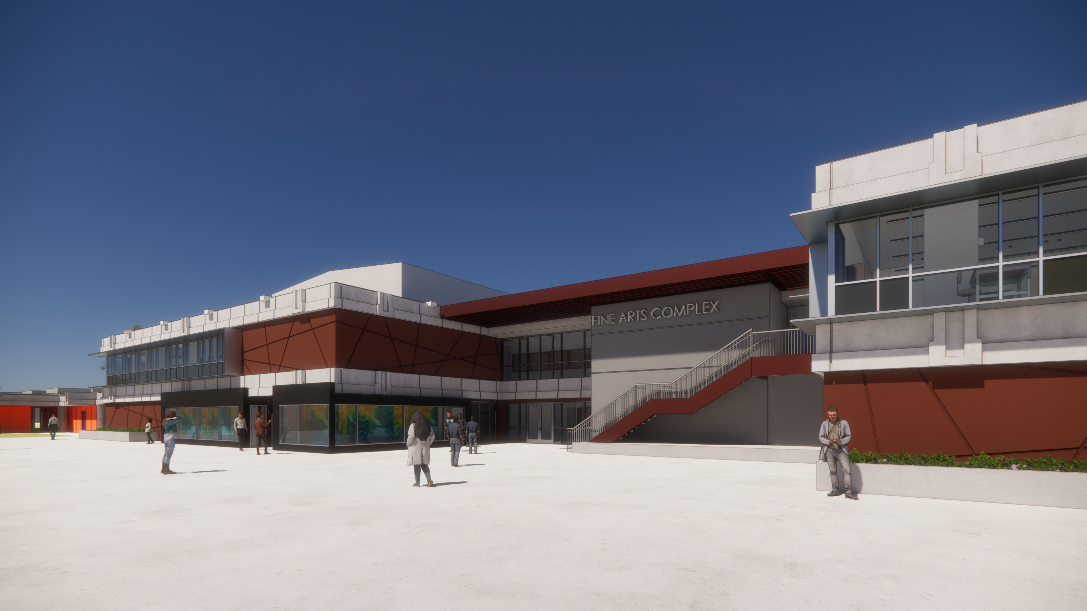
Golden West College
Fine Arts Renovation
Current Phase: In Design Architect: Tbp Architecture Contractor: Multi-Prime
Construction Manager: N/A
The Fine Arts Renovation project at Golden West College will do a full gut and reconfiguration of one of the two wings of the existing Fine Arts Building. The other smaller wing will be demolished upon completion of the project.

Slide 13
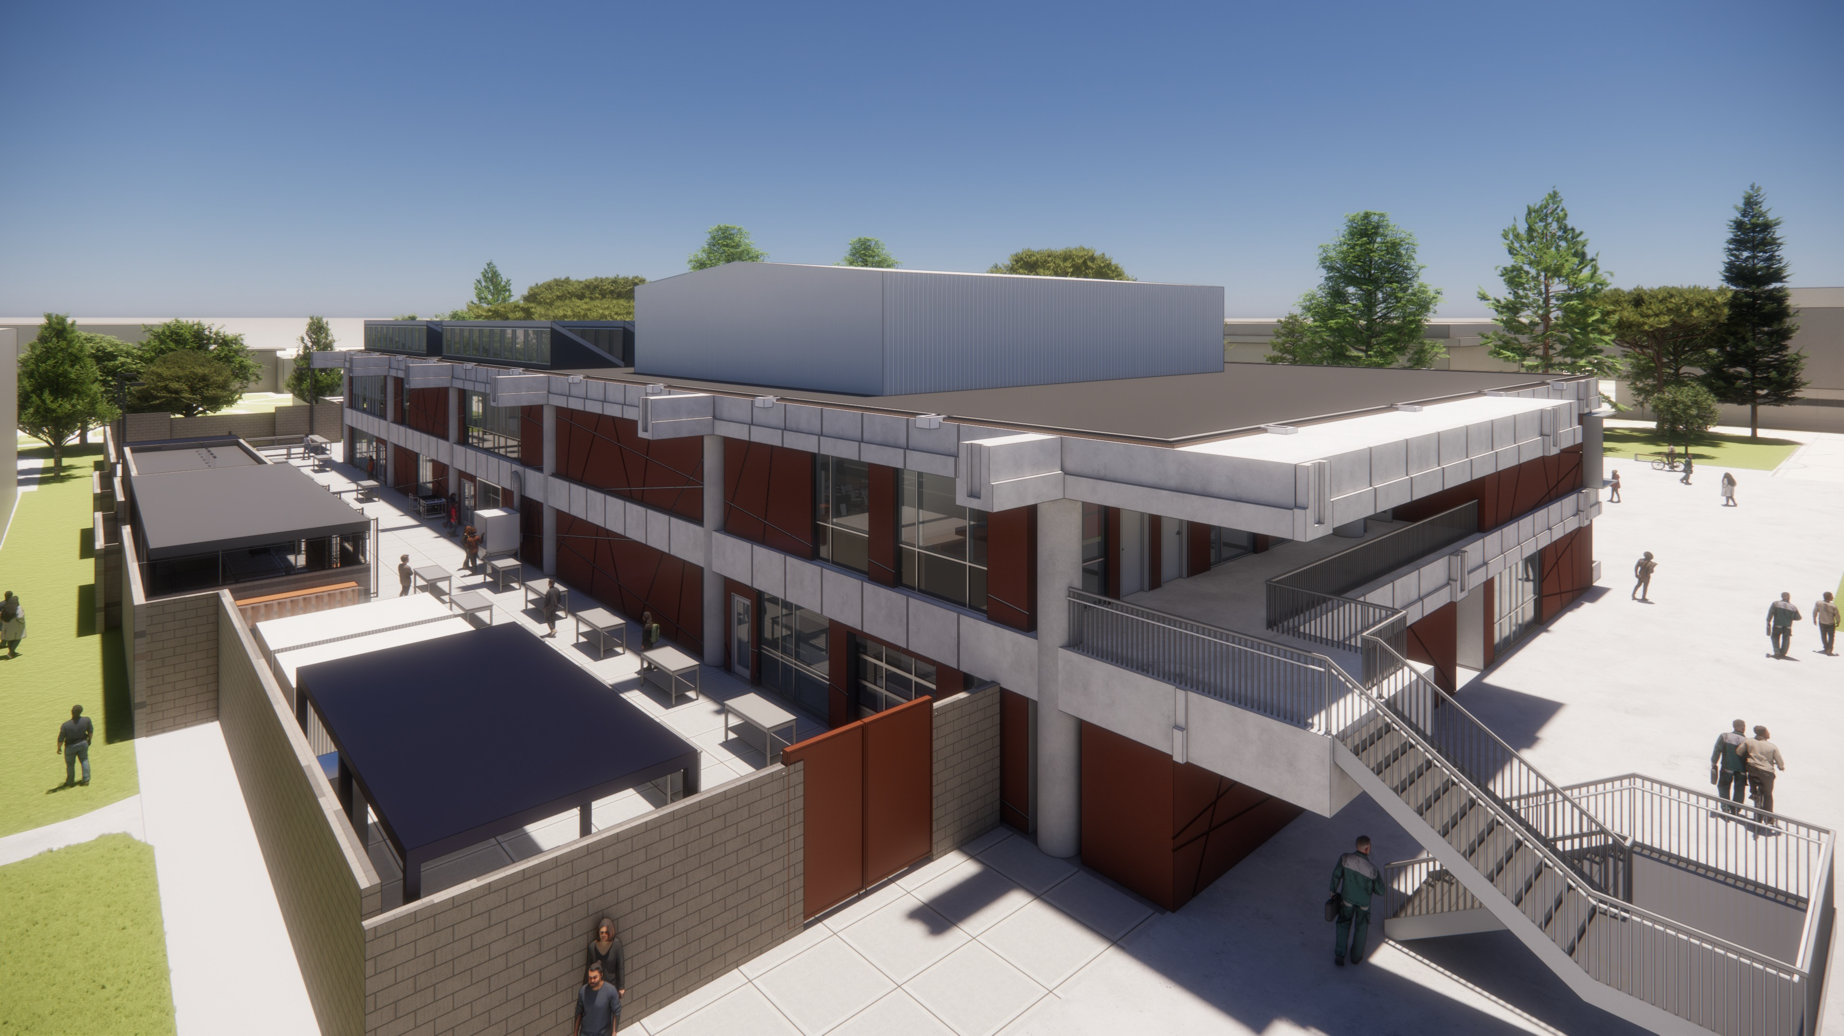
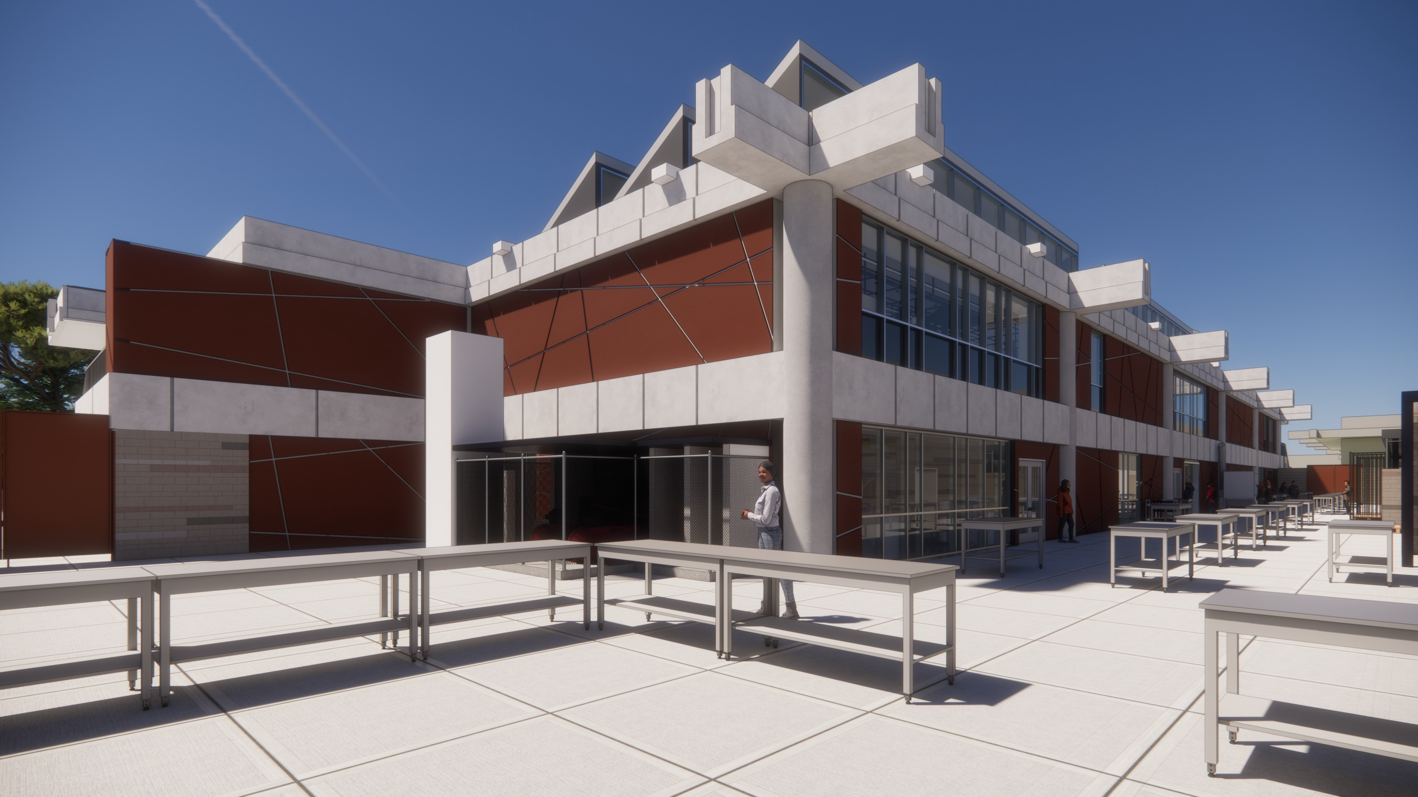
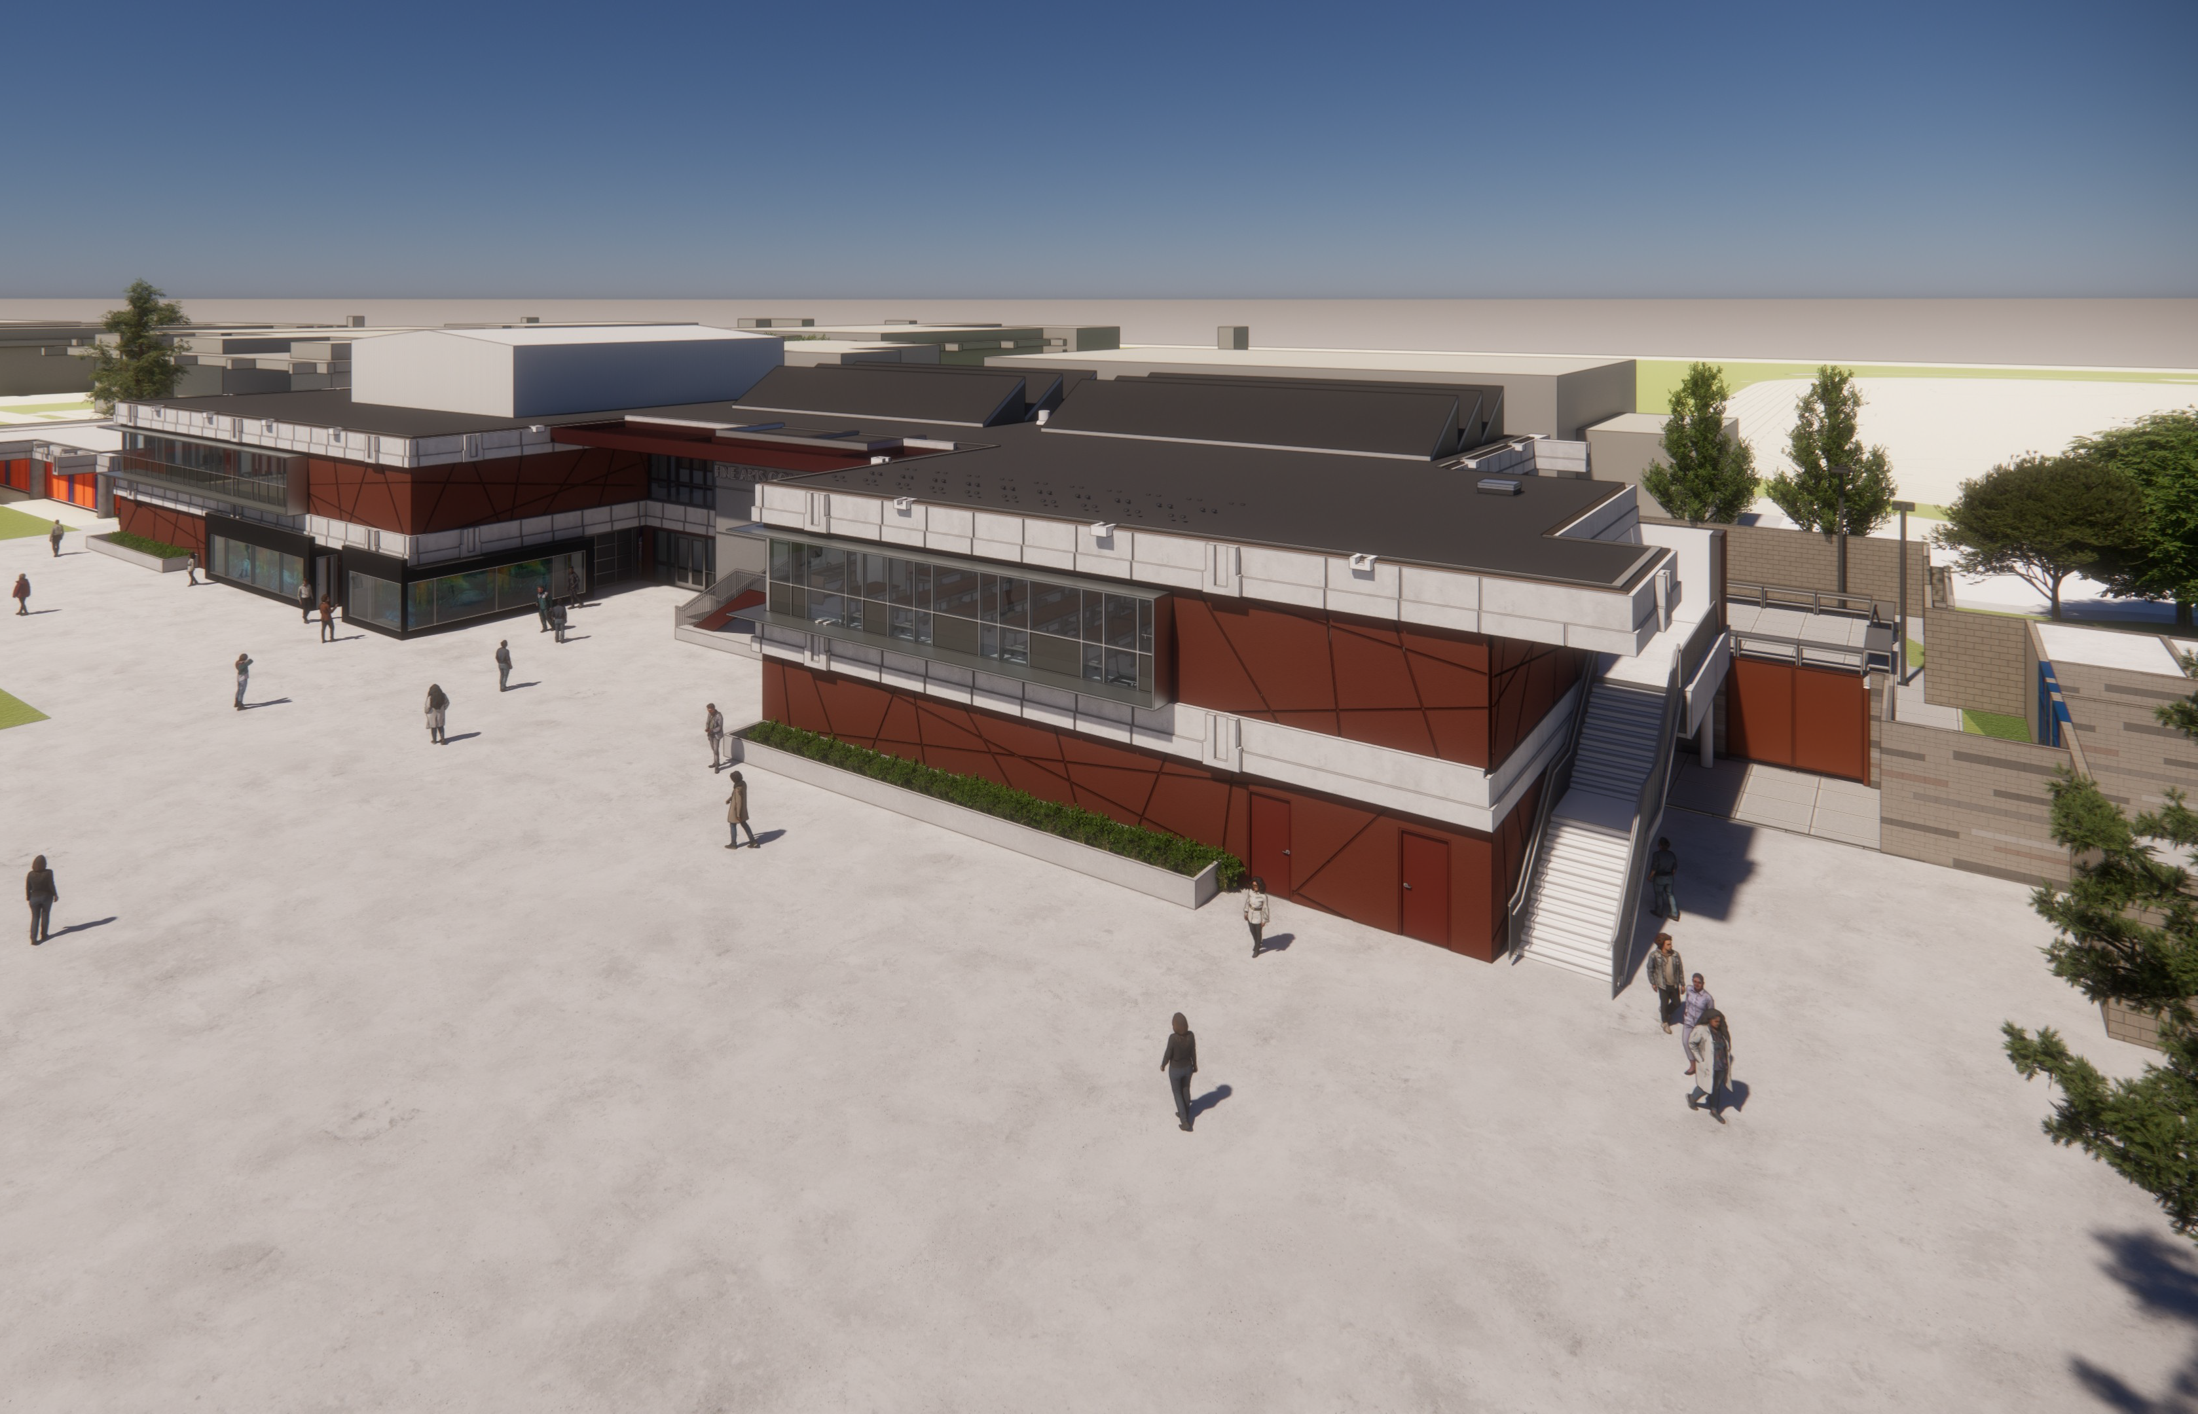
Golden West College
Fine Arts Renovation

Slide 14
Golden West College
Fine Arts Renovation
 | Budget | Biannual Expenses | Total Expended | Balance Remaining
Construction | $12,685,720 | $0 | $0 | $12,685,720
Soft Cost | $2,500,000 | $1,005,561 | $1,398,155 | $1,101,845
FFE/IT | $2,344,000 | $0 | $0 | $2,344,000
Contingency | $1,727,499 |  |  | $1,727,499
TOTAL | $19,257,219 | $1,005,561 | $1,398,155 | $17,859,064
BUDGET
 | Start
Design | December 2023
Plan Review | February 2024
Bidding | March 2025
Construction | May 2025
Project Completion | March 2027
Closeout | July 2027
Status Update: Preliminary plans completed. DSA Plan review scheduled. Geotechnical engineer has completed boring samples and provided analysis.
SCHEDULE
*The Fine Arts Renovation is a 50/50 state funded project. Total project funding is captured in the split budget summary slide.
BIANNUAL REPORT: 4/1/24 – 9/30/24
Page 14

Slide 15
Orange Coast College
Chemistry
Current Phase: In Construction Architect: tBP Architecture Contractor: Multiple Prime
Construction Manager: C.W. Driver
Scope: The Chemistry Building will replace the existing facility to result in academic spaces that are more efficient and productive, safer, and more technologically relevant for today’s teaching/ learning environment while also providing additional space needed for the growing Chemistry program.

Slide 16
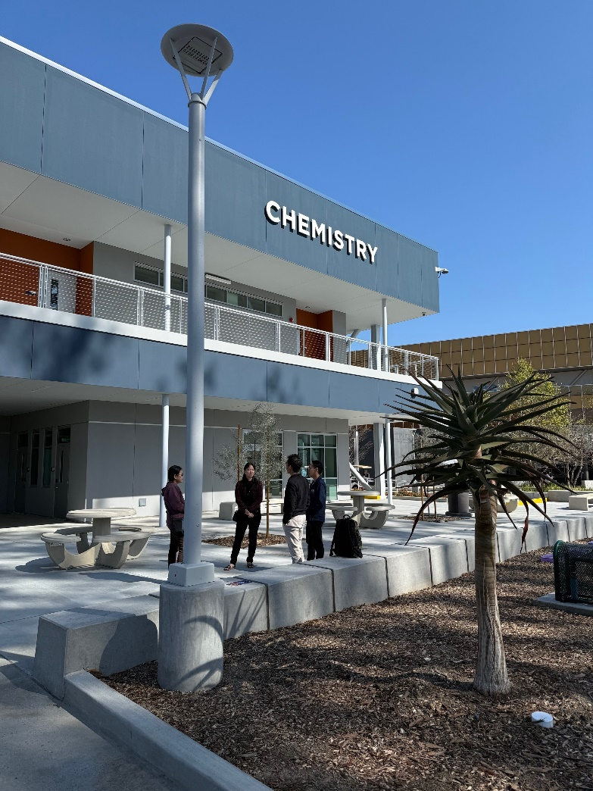
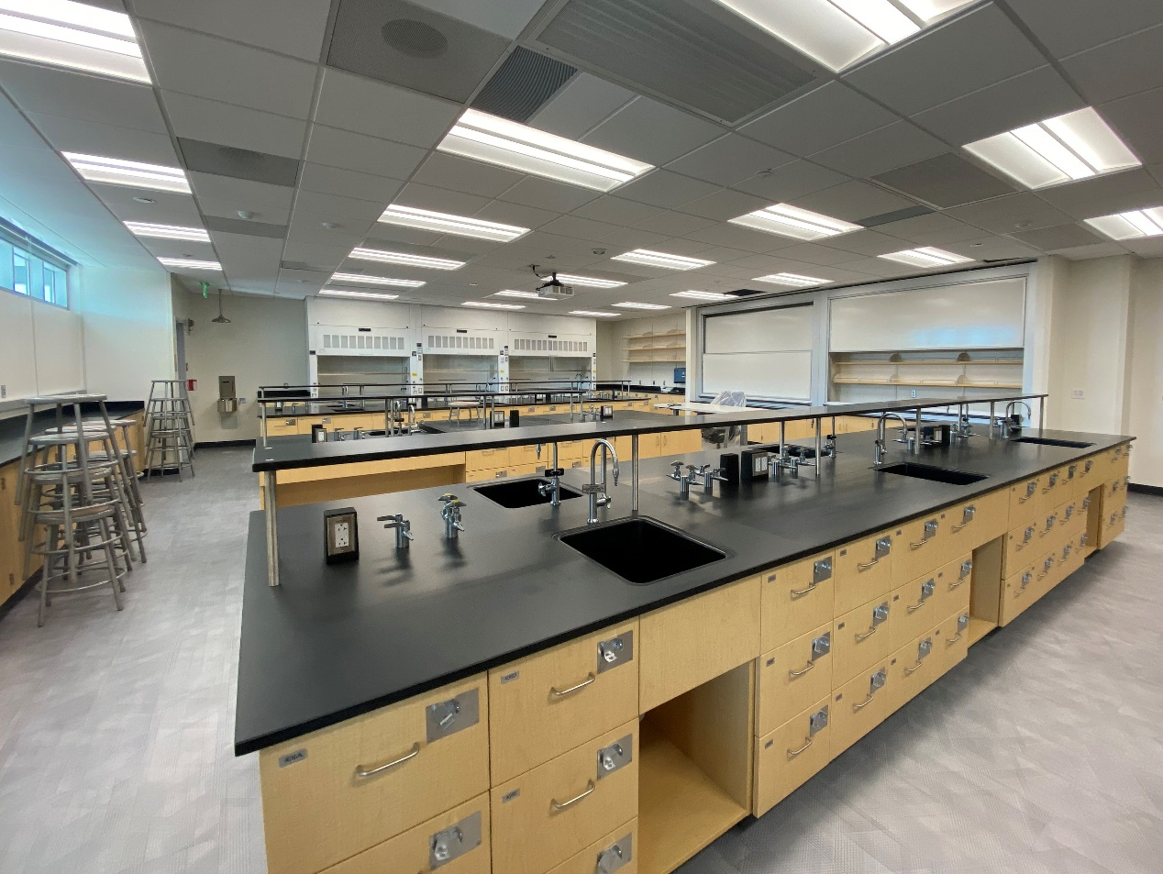
Orange Coast College
Chemistry

Slide 17
Orange Coast College
Chemistry
 | Budget | Biannual Expenses | Total Expended | Balance Remaining
Construction | $19,132,027 | $11,441,781 | $18,687,088 | $444,939
Soft Cost | $3,930,650 | $773,320 | $3,408,667 | $521,983
FFE/IT | $892,287 | $308,743 | $542,191 | $350,096
Contingency | $338,589 |  |  | $338,589
TOTAL | $24,293,553 | $12,523,844 | $22,637,946 | $1,655,607
BUDGET
 | Start
Design | January 2021
Plan Review | August 2021
Bidding | July 2022
Construction | October 2022
Project Completion | September 2024
Closeout | December 2024
Status Update: Building construction complete. Site landscaping and concrete work ongoing.
*Chemistry Project is a 50/50 state funded project. Negative balance is a result of Measure M originally absorbing all expenses, 50% of which will be reimbursed by State Proposition 51 funds.
SCHEDULE
BIANNUAL REPORT: 4/1/24 – 9/30/24
Page 17

Slide 18
$17,145,010
Total Biannual Expenses
$618,190,645
Total Expenses From Inception
96.90%
Percentage of Project Funds Expended

